Slide 1
Behavioral Design Patterns
Software Design Patterns
CPIT-251

Slide 2
Behavioral Design Patterns
Behavioral patterns are concerned with algorithms and the assignment of responsibilities between objects
Behavioral patterns describe not just patterns of objects or classes but also the patterns of communication between them
Behavioral class patterns use inheritance and object composition to distribute behavior between classes
Provide loose coupling between objects, and maintain dependencies between objects

Slide 3
Behavioral Design Patterns
Chain of Responsibility
Command
Iterator
Mediator
Memento
Observer
State
Strategy
Template Method
Visitor
Interpreter

Slide 4
Chain Of Responsibility Design Pattern
Intent
Avoid coupling the sender of a request to its receiver by giving more than one object a chance to handle the request
Chain the receiving objects and pass the request along the chain until an object handles it

Slide 5
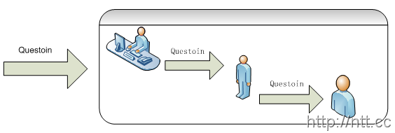
Chain Of Responsibility Design Pattern
Motivation

Slide 6
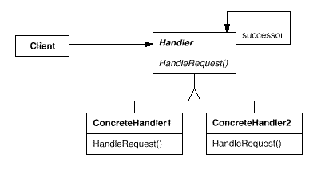
Chain Of Responsibility Design Pattern
Structure

Slide 7
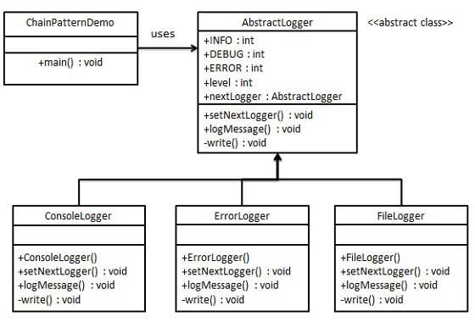
Chain Of Responsibility Design Pattern
Example
Info message -> Console Logger
Debug Message -> File Logger
Error Message -> Error Logger

Slide 8
public abstract class AbstractLogger {
public static int INFO = 1;
public static int DEBUG = 2;
public static int ERROR = 3;
protected int level;
protected AbstractLogger nextLogger;
public void setNextLogger(AbstractLogger nextLogger){
this.nextLogger = nextLogger; }
public void logMessage(int level, String message){
if(this.level <= level){
write(message); }
if(nextLogger !=null){
nextLogger.logMessage(level, message); }
}
abstract protected void write(String message);
}
Next element in chain or responsibility

Slide 9
public class ConsoleLogger extends AbstractLogger {
public ConsoleLogger(int level){
this.level = level; }
@Override
protected void write(String message) {
System.out.println("Standard Console::Logger: " + message);
}
}

Slide 10
public class ErrorLogger extends AbstractLogger {
public ErrorLogger(int level){
this.level = level; }
@Override
protected void write(String message) {
System.out.println("Error Console::Logger: " + message);
}
}

Slide 11
public class FileLogger extends AbstractLogger {
public FileLogger(int level){
this.level = level;
}
@Override
protected void write(String message) {
System.out.println("File::Logger: " + message);
}
}

Slide 12
public class Client {
public static void main(String[] args){
AbstractLogger errorLogger = new ErrorLogger(AbstractLogger.ERROR);
AbstractLogger fileLogger = new FileLogger(AbstractLogger.DEBUG);
AbstractLogger consoleLogger = new ConsoleLogger(AbstractLogger.INFO);
errorLogger.setNextLogger(fileLogger);
fileLogger.setNextLogger(consoleLogger);
errorLogger.logMessage(AbstractLogger.INFO, "This is an information.");
errorLogger.logMessage(AbstractLogger.DEBUG, "This is a debug level information.");
errorLogger.logMessage(AbstractLogger.ERROR, "This is an error level information.");
}
}
Info message -> Console Logger
Debug Message -> File Logger
Error Message -> Error Logger
Error Logger (level 3) -> File Logger (level 2) -> Console Logger (level 1)

Slide 13
Output:
Standard Console::Logger: This is an information.
------------------
File::Logger: This is a debug level information.
Standard Console::Logger: This is a debug level information.
------------------
Error Console::Logger: This is an error level information.
File::Logger: This is an error level information.
Standard Console::Logger: This is an error level information.

Slide 14
Chain Of Responsibility Design Pattern
Applicability:
More than one object may handle a request, and the handler isn't known a priori. The handler should be ascertained automatically
You want to issue a request to one of several objects without specifying the receiver explicitly
The set of objects that can handle a request should be specified dynamically.

Slide 15
Chain Of Responsibility Design Pattern
Consequences:
Reduced coupling. The pattern frees an object from knowing which other object handles a request
Added flexibility in assigning responsibilities to objects. Chain of Responsibility gives you added flexibility in distributing responsibilities among objects

Slide 16
Command Design Pattern
Intent
A request is wrapped under an object as command and passed to invoker object. Invoker object looks for the appropriate object which can handle this command and passes the command to the corresponding object which executes it.
An object is used to represent and encapsulate all information needed to call a method at a later time
Support undoable operations

Slide 17
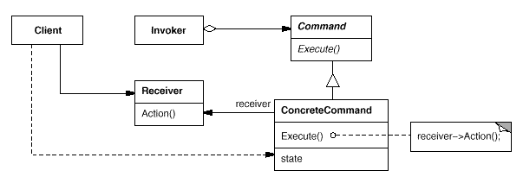
Command Design Pattern
Structure

Slide 18
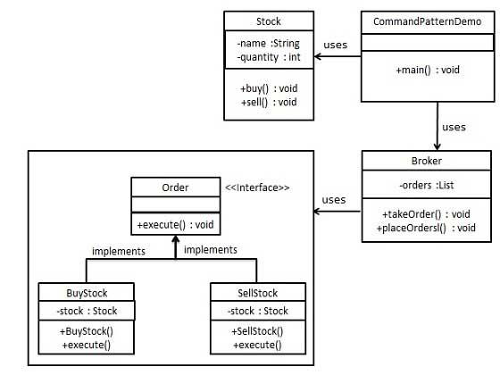
Command Design Pattern
Example
Receiver
Invoker
Command

Slide 19
public interface Order {
void execute();
}
public class BuyStock implements Order {
private Stock abcStock;
public BuyStock(Stock abcStock){
this.abcStock = abcStock; }
public void execute() {
abcStock.buy(); }
}

Slide 20
public class SellStock implements Order {
private Stock abcStock;
public SellStock(Stock abcStock){
this.abcStock = abcStock; }
public void execute() {
abcStock.sell(); }
}

Slide 21
import java.util.ArrayList;
import java.util.List;
public class Broker {
public void placeOrders(Order order){ order.execute();
}
}

Slide 22
public class Stock {
private String name = "ABC";
private int quantity = 10;
public void buy(){
System.out.println("Stock [ Name: "+name+", Quantity: " + quantity +" ] bought");
}
public void sell(){
System.out.println("Stock [ Name: "+name+", Quantity: " +
quantity +" ] sold");
}
}

Slide 23
public class CommandPatternDemo {
public static void main(String[] args) {
Stock abcStock = new Stock();
BuyStock buyStockOrder = new BuyStock(abcStock);
SellStock sellStockOrder = new SellStock(abcStock);
Broker broker = new Broker();
broker.placeOrders(buyStockOrder);
broker.placeOrders(sellStockOrder);
}
}

Slide 24
Output:
Stock [ Name: ABC, Quantity: 10 ] bought
Stock [ Name: ABC, Quantity: 10 ] sold

Slide 25
Command Design Pattern
Applicability and consequences:
Command decouples the object that invokes the operation from the one that knows how to perform it
It's easy to add new Commands, because you don't have to change existing classes
Support undo operations

Slide 26
public interface Order {
public void execute();
public void undo();
}
public class BuyStock implements Order {
private Stock abcStock;
public BuyStock(Stock abcStock){
this.abcStock = abcStock; }
public void execute() {
abcStock.buy(); }
public void undo() {
abcStock.sell();
}
}

Slide 27
public class SellStock implements Order {
private Stock abcStock;
public SellStock(Stock abcStock){
this.abcStock = abcStock; }
public void execute() {
abcStock.sell(); }
public void undo() {
abcStock.buy();
}
}

Slide 28
import java.util.ArrayList;
import java.util.List;
public class Broker {
public void placeOrders(Order order){ order.execute();
}
public void undoOrders(Order order){ order.undo();
}
}

Slide 29
public class Stock {
private String name = "ABC";
private int quantity = 10;
public void buy(){
System.out.println("Stock [ Name: "+name+", Quantity: " + quantity +" ] bought");
}
public void sell(){
System.out.println("Stock [ Name: "+name+", Quantity: " +
quantity +" ] sold");
}
}

Slide 30
public class CommandPatternDemo {
public static void main(String[] args) {
Stock abcStock = new Stock();
BuyStock buyStockOrder = new BuyStock(abcStock);
SellStock sellStockOrder = new SellStock(abcStock);
Broker broker = new Broker();
broker.placeOrders(buyStockOrder);
broker.placeOrders(sellStockOrder);
broker.undoOrders(buyStockOrder);
broker.undoOrders(sellStockOrder);
}
}

Slide 31
Iterator Design Pattern
Intent:
Provide a way to access the elements of collections sequentially without exposing its underlying representation

Slide 32
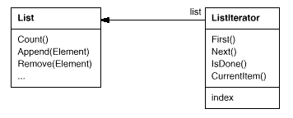
Iterator Design Pattern
Motivation

Slide 33
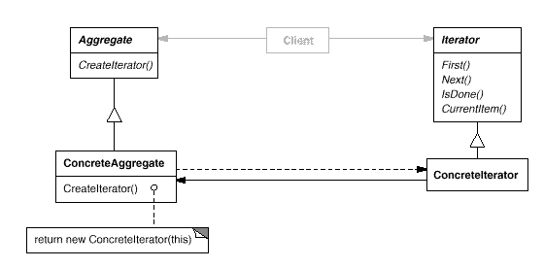
Iterator Design Pattern
Structure

Slide 34
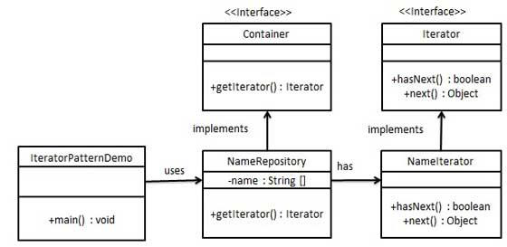
Iterator Design Pattern
Example

Slide 35
public interface Iterator {
public boolean hasNext();
public String next();
}

Slide 36
public class NameIterator implements Iterator {
String names[];
int index;
public NameIterator(String[] newName){
this.names = newName;}
@Override
public boolean hasNext() {
if(index <names.length){
return true;}
return false;}
@Override
public String next() {
if(this.hasNext()){
return names[index++]; }
return null;}
}

Slide 37
public interface Container {
public Iterator getIterator();
}
public class NameRepository implements Container {
public String names[] = {"Robert" , "John" ,"Julie" , "Lora"};
@Override
public Iterator getIterator() {
return new NameIterator(names);
}
}

Slide 38
public class Client {
public static void main(String[] args) {
NameRepository namesRepository = new NameRepository();
Iterator iter = namesRepository.getIterator();
while (iter.hasNext()){
String name = (String)iter.next();
System.out.println("Name : " + name);
}
}
}

Slide 39
Output
Name : Robert
Name : John
Name : Julie
Name : Lora

Slide 40
Iterator Design Pattern
Applicability and Consequences
To access an aggregate object's contents without exposing its internal representation.
To support multiple traversals of aggregate objects by providing a uniform interface for traversing different aggregate structures

Slide 41
Mediator Design Pattern
Intent
This pattern provides a mediator class which normally handles all the communications between different classes and supports easy maintenance of the code by loose coupling

Slide 42
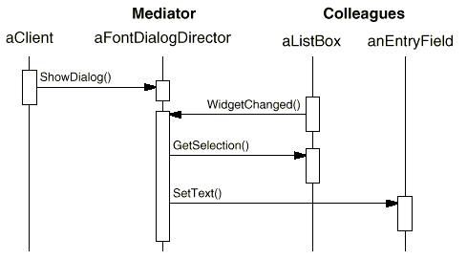
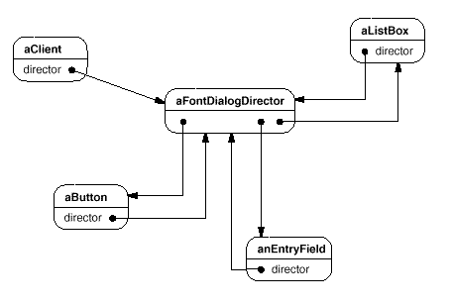
Mediator Design Pattern
Motivation

Slide 43
Mediator Design Pattern
Structure

Slide 44
Mediator Design Pattern
Example

Slide 45
public class User {
private String name;
public String getName() {
return name; }
public void setName(String name) {
this.name = name;}
public User(String name){
this.name = name;}
public void sendMessage(String message){
ChatRoom.showMessage(this,message);}
}

Slide 46
import java.util.Date;
public class ChatRoom {
public static void showMessage(User user, String message){
System.out.println(new Date().toString() + " [" + user.getName() + "] : " + message);
}
}

Slide 47
public class Client {
public static void main(String[] args) {
User robert = new User("Robert");
User john = new User("John");
robert.sendMessage("Hi! John!");
john.sendMessage("Hello! Robert!");
}
}

Slide 48
Output:
Thu Jan 31 16:05:46 IST 2013 [Robert] : Hi! John!
Thu Jan 31 16:05:46 IST 2013 [John] : Hello! Robert!

Slide 49
Mediator Design Pattern
Applicability
A set of objects communicate in well-defined but complex ways. The resulting interdependencies are unstructured and difficult to understand
Reusing an object is difficult because it refers to and communicates with many other objects

Slide 50
Mediator Design Pattern
Consequences
A mediator promotes loose coupling between colleagues. You can vary and reuse Colleague and Mediator classes independently
A mediator replaces many-to-many interactions with one-to-many interactions between the mediator and its colleagues. One-to-many relationships are easier to understand, maintain, and extend
The Mediator pattern trades complexity of interaction for complexity in the mediator. This can make the mediator itself a monolith that's hard to maintain.

Slide 51
Memento Design pattern
Intent
A way to store object’s previous state so the object can be restored to its state later

Slide 52
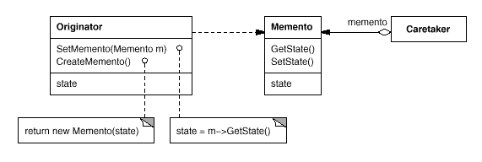
Memento Design pattern
Structure

Slide 53
public class Memento {
private String article;
public Memento(String articleSave) { article = articleSave; }
public String getSavedArticle() { return article; }
}
The article stored in memento Object
Save a new article String to the memento Object
Return the value stored in article

Slide 54
public class Originator {
private String article;
public void set(String newArticle) {
System.out.println("From Originator: Current Version of Article \n"+newArticle+ "\n");
this.article = newArticle; }
public Memento storeInMemento() {
System.out.println("From Originator: Saving to Memento");
return new Memento(article);
}
public String restoreFromMemento(Memento memento) {
article = memento.getSavedArticle();
System.out.println("\n From Originator: Previous Article Saved in Memento\n"+article + "\n");
return article;
}
}
Sets the value for the article
Creates a new Memento with a new article
Gets the article currently stored in memento

Slide 55
import java.util.ArrayList;
public class CareTaker {
ArrayList<Memento> savedArticles = new ArrayList<Memento>();
public void addMemento(Memento m) { savedArticles.add(m); }
public Memento getMemento(int index) {
return savedArticles.get(index); }
}
Where all mementos are saved
Adds memento to the ArrayList
Gets the memento requested from the ArrayList

Slide 56
public class Client {
public static void main(String[] args) {
int saveFiles = 0, currentArticle = 0;
String theArticle;
CareTaker caretaker = new CareTaker();
Originator originator = new Originator();
originator.set("Article 1: I walked. ");
caretaker.addMemento( originator.storeInMemento() );
saveFiles++;
currentArticle++;
System.out.println("Save Files " + saveFiles);
System.out.println("Current Article " + currentArticle);
originator.set("Article 2: I walked in the street. ");
caretaker.addMemento( originator.storeInMemento() );
saveFiles++;
currentArticle++;
System.out.println("Save Files " + saveFiles);
System.out.println("Current Article " + currentArticle);

Slide 57
if (currentArticle >= 1){
currentArticle--;
theArticle= originator.restoreFromMemento(caretaker.getMemento(currentArticle));
System.out.println("Save Files " + saveFiles);
System.out.println("Current Article " + currentArticle);
}
else
System.out.println("\n There are no more saved articles.");
if (currentArticle >= 1){
currentArticle--;
theArticle= originator.restoreFromMemento(caretaker.getMemento(currentArticle));
System.out.println("Save Files " + saveFiles);
System.out.println("Current Article " + currentArticle);
}
else
System.out.println("\n There are no more saved articles.");

Slide 58
if ((saveFiles - 1) > currentArticle){
currentArticle++;
theArticle = originator.restoreFromMemento( caretaker.getMemento(currentArticle) );
System.out.println("Save Files " + saveFiles);
System.out.println("Current Article " + currentArticle);
}
}
}

Slide 59
//save to memento
From Originator: Current Version of Article
Article 1: I walked.
From Originator: Saving to Memento
Save Files 1
Current Article 1
//-------------------
From Originator: Current Version of Article
Article 2: I walked in the street.
From Originator: Saving to Memento
Save Files 2
Current Article 2
//---------------------

Slide 60
//undo
From Originator: Previous Article Saved in Memento
Article 2: I walked in the street.
Save Files 2
Current Article 1
//undo
From Originator: Previous Article Saved in Memento
Article 1: I walked.
Save Files 2
Current Article 0
//redo
From Originator: Previous Article Saved in Memento
Article 2: I walked in the street.
Save Files 2
Current Article 1

Slide 61
Memento Design pattern
Applicability
An object's state must be saved so that it can be restored to that state later, and
A direct interface to obtaining the state would expose implementation details and break the object’s encapsulation.

Slide 62
Memento Design pattern
Consequences
Memento avoids exposing information that only an originator should manage but that must be stored nevertheless outside the originator
It simplifies Originator. In other encapsulation-preserving designs, Originator keeps the versions of internal state that clients have requested. That puts all the storage management burden on Originator
Mementos might incur considerable overhead if Originator must copy large amounts of information to store in the memento or if clients create and return mementos to the originator often enough

Slide 63
Observer Design Pattern
Intent
Define a one-to-many dependency between objects so that when one object changes state, all its dependents are notified and updated automatically.

Slide 64
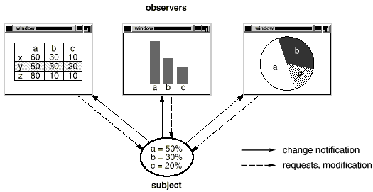
Observer Design Pattern
Motivation

Slide 65
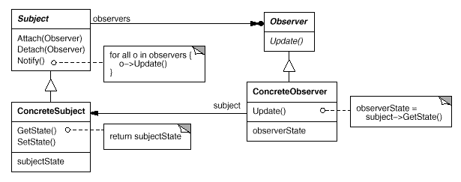
Observer Design Pattern
Structure

Slide 66
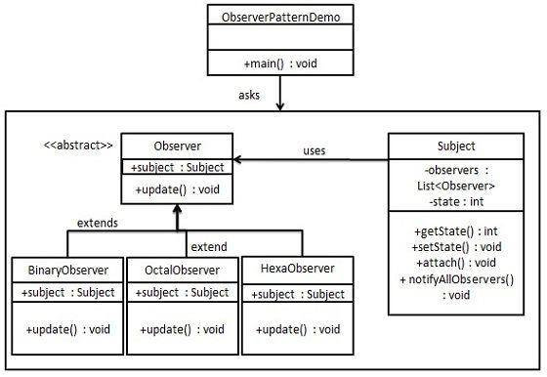
Observer Design Pattern
Example

Slide 67
import java.util.ArrayList;
import java.util.List;
public class Subject {
private List<Observer> observers = new ArrayList<Observer>();
private int state;
public int getState() { return state; }
public void setState(int state) {
this.state = state;
notifyAllObservers(); }
public void attach(Observer observer){
observers.add(observer); }
public void notifyAllObservers(){
for (Observer observer : observers) {
observer.update(); }
}
}

Slide 68
public abstract class Observer {
protected Subject subject;
public abstract void update();
}
public class BinaryObserver extends Observer{
public BinaryObserver(Subject subject){
this.subject = subject;
this.subject.attach(this); }
@Override
public void update() {
System.out.println( "Binary String: ” + Integer.toBinaryString( subject.getState() ) );
}
}

Slide 69
public class OctalObserver extends Observer{
public OctalObserver(Subject subject){
this.subject = subject;
this.subject.attach(this); }
@Override
public void update() {
System.out.println( "Octal String: ” + Integer.toOctalString( subject.getState() ) );
}
}

Slide 70
public class HexaObserver extends Observer{
public HexaObserver(Subject subject){
this.subject = subject;
this.subject.attach(this); }
@Override
public void update() {
System.out.println( "Hex String: ” + Integer.toHexString( subject.getState() ).toUpperCase() );
}
}

Slide 71
public class ObserverPatternDemo {
public static void main(String[] args) {
Subject subject = new Subject();
new HexaObserver(subject);
new OctalObserver(subject);
new BinaryObserver(subject);
System.out.println("First state change: 15");
subject.setState(15);
System.out.println("Second state change: 10");
subject.setState(10);
}
}

Slide 72
Output:
First state change: 15
Hex String: F
Octal String: 17
Binary String: 1111
Second state change: 10
Hex String: A
Octal String: 12
Binary String: 1010

Slide 73
Observer Design Pattern
Applicability
When a change to one object requires changing others, and you don't know how many objects need to be changed
When an object should be able to notify other objects without making assumptions about who these objects are. In other words, you don't want these objects tightly coupled.

Slide 74
Observer Design Pattern
Consequences
Abstract coupling between Subject and Observer. All a subject knows is that it has a list of observers. The subject doesn't know the concrete class of any observer. Thus the coupling between subjects and observers is abstract and minimal
Support for broadcast communication. The notification is broadcast automatically to all interested objects that subscribed to it
Unexpected updates. Because observers have no knowledge of each other's presence. Operation on the subject may cause a cascade of updates to observers and their dependent objects , which can be hard to track down

Slide 75
State Design Pattern
Intent
Allow an object to change its state based on its internal state

Slide 76
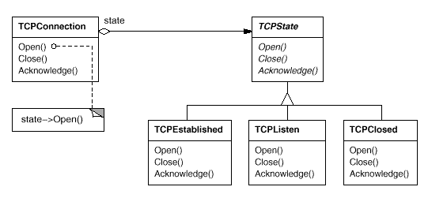
State Design Pattern
Motivation

Slide 77
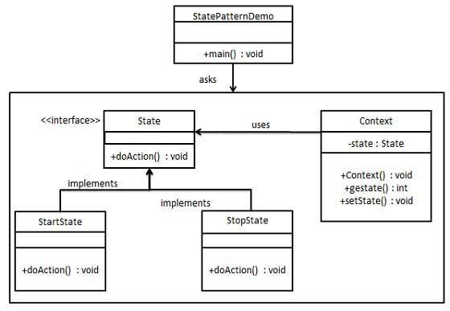
State Design Pattern
Example

Slide 78
public class Context {
private State state;
public Context(){
state = null;}
public void setState(State state){
this.state = state;}
public State getState(){
return state;}
}

Slide 79
public interface State {
public void doAction(Context context);
}
public class StopState implements State {
public void doAction(Context context) {
System.out.println("Player is in stop state");
context.setState(this);
}
public String toString(){
return "Stop State”;
}
}

Slide 80
public class StartState implements State {
public void doAction(Context context) {
System.out.println("Player is in start state");
context.setState(this);
}
public String toString(){
return "Start State";
}
}

Slide 81
public class Client {
public static void main(String[] args) {
Context context = new Context();
StartState startState = new StartState();
startState.doAction(context);
System.out.println(context.getState().toString());
StopState stopState = new StopState();
stopState.doAction(context);
System.out.println(context.getState().toString());
}
}

Slide 82
Output
Player is in start state
Start State
Player is in stop state
Stop State

Slide 83
State Design Pattern
Applicability
An object's behavior depends on its state, and it must change its behavior at run-time depending on that state.
Operations have large, multipart conditional statements that depend on the object's state. The State pattern puts each branch of the conditional in a separate class. This lets you treat the object's state as an object in its own right that can vary independently from other objects

Slide 84
Strategy Design Pattern
Intent
Define a family of algorithms or strategies, encapsulate each one, and make them interchangeable.
A class strategy or its algorithm can be changed at run time
Strategy lets the algorithm vary independently from clients that use it

Slide 85
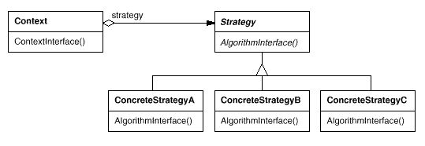
Strategy Design Pattern
Structure

Slide 86
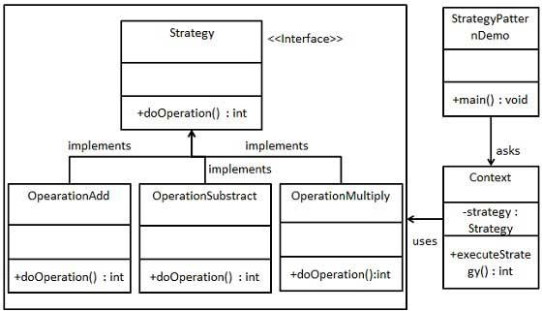
Strategy Design Pattern
Example

Slide 87
public interface Strategy {
public int doOperation(int num1, int num2);
}
public class OperationAdd implements Strategy{
@Override
public int doOperation(int num1, int num2) {
return num1 + num2;
}
}

Slide 88
public class OperationSubstract implements Strategy{
@Override
public int doOperation(int num1, int num2) {
return num1 - num2;
}
}
public class OperationMultiply implements Strategy{
@Override
public int doOperation(int num1, int num2) {
return num1 * num2;
}
}

Slide 89
public class Context {
private Strategy strategy;
public Context(Strategy strategy){
this.strategy = strategy;
}
public int executeStrategy(int num1, int num2){
return strategy.doOperation(num1, num2);
}
}

Slide 90
public class StrategyPatternDemo {
public static void main(String[] args) {
Context context = new Context(new OperationAdd());
System.out.println("10 + 5 = " + context.executeStrategy(10, 5));
context = new Context(new OperationSubstract());
System.out.println("10 - 5 = " + context.executeStrategy(10, 5));
context = new Context(new OperationMultiply());
System.out.println("10 * 5 = " + context.executeStrategy(10, 5));
}
}

Slide 91
Output
10 + 5 = 15
10 - 5 = 5
10 * 5 = 50

Slide 92
Strategy Design Pattern
Applicability
many related classes differ only in their behavior. Strategies provide a way to configure a class with one of many behaviors
An algorithm uses data that clients shouldn't know about. Use the Strategy pattern to avoid exposing complex, algorithm-specific data structures.

Slide 93
Strategy Design Pattern
Consequences
Strategies eliminate conditional statements
A choice of implementations. Strategies can provide different implementations of the same behavior
Clients must be aware of different Strategies. The pattern has a potential drawback in that a client must understand how Strategies differ before it can select the appropriate one

Slide 94
Template Design Pattern
Intent
Template Method lets subclasses redefine certain steps of an algorithm without changing the algorithm's structure
An abstract class defines template(s) to execute its methods. Its subclasses can override the method implementation.

Slide 95
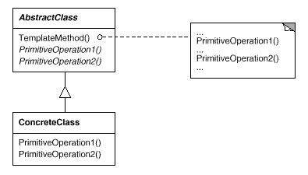
Template Design Pattern
Structure

Slide 96
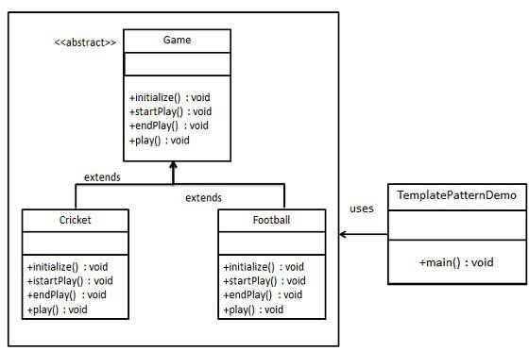
Template Design Pattern
Example

Slide 97
public abstract class Game {
abstract void initialize();
abstract void startPlay();
abstract void endPlay();
public final void play(){
initialize();
startPlay();
endPlay();
}
}
Template method should be final to not be changed by subclasses
Template method

Slide 98
public class Cricket extends Game {
@Override
void endPlay() {
System.out.println("Cricket Game Finished!");
}
@Override
void initialize() {
System.out.println("Cricket Game Initialized! Start playing.");
}
@Override
void startPlay() {
System.out.println("Cricket Game Started. Enjoy the game!");
}
}

Slide 99
public class Football extends Game {
@Override
void endPlay() {
System.out.println("Football Game Finished!");
}
@Override
void initialize() {
System.out.println("Football Game Initialized! Start playing.");
}
@Override
void startPlay() {
System.out.println("Football Game Started. Enjoy the game!");
}
}

Slide 100
public class TemplatePatternDemo {
public static void main(String[] args) {
Game game = new Cricket();
game.play();
System.out.println();
game = new Football();
game.play();
}
}
Output:
Cricket Game Initialized! Start playing.
Cricket Game Started. Enjoy the game!
Cricket Game Finished!
Football Game Initialized! Start playing.
Football Game Started. Enjoy the game!
Football Game Finished!

Slide 101
Template Design Pattern
Applicability
To implement the invariant parts of an algorithm once and leave it up to subclasses to implement the behavior that can vary
When common behavior among subclasses should be factored and localized in a common class to avoid code duplication
To control subclasses extensions. You can define a template method that calls "hook" operations at specific points, thereby permitting extensions only at those points.

Slide 102
Visitor Design Pattern
Intent
Represent an operation to be performed on the elements of an object structure.
Visitor lets you define a new operation without changing the classes of the elements on which it operates.

Slide 103
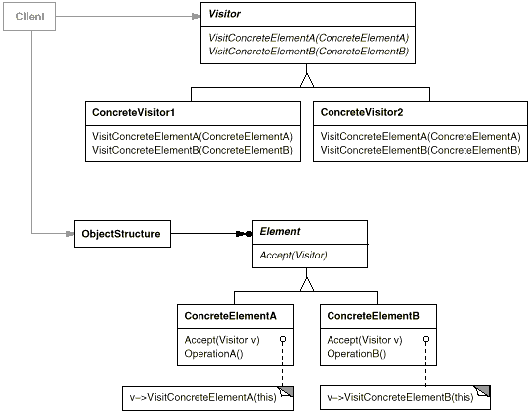
Visitor Design Pattern
Structure

Slide 104
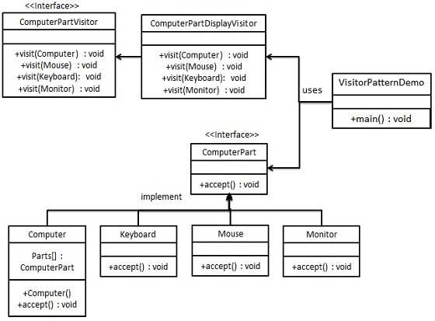
Visitor Design Pattern
Example

Slide 105
Element Interface
public interface ComputerPart {
public void accept(ComputerPartVisitor computerPartVisitor);
}
Concert element
public class Keyboard implements ComputerPart {
@Override
public void accept(ComputerPartVisitor computerPartVisitor) {
computerPartVisitor.visit(this);
}
}

Slide 106
Concert element
public class Monitor implements ComputerPart {
@Override
public void accept(ComputerPartVisitor computerPartVisitor) {
computerPartVisitor.visit(this);
}
}
Concert element
public class Mouse implements ComputerPart {
@Override
public void accept(ComputerPartVisitor computerPartVisitor) {
computerPartVisitor.visit(this);
}
}

Slide 107
Concert element
public class Computer implements ComputerPart {
ComputerPart[] parts;
public Computer(){
parts = new ComputerPart[] {new Mouse(), new Keyboard(), new Monitor()}; }
@Override
public void accept(ComputerPartVisitor computerPartVisitor) {
for (int i = 0; i < parts.length; i++) {
parts[i].accept(computerPartVisitor);
}
computerPartVisitor.visit(this);
}
}

Slide 108
Visitor Interface
public interface ComputerPartVisitor {
public void visit(Computer computer);
public void visit(Mouse mouse);
public void visit(Keyboard keyboard);
public void visit(Monitor monitor);
}
Visit operation for each concrete class from
the element structure

Slide 109
public class ComputerPartDisplayVisitor implements ComputerPartVisitor {
@Override
public void visit(Computer computer) {
System.out.println("Displaying Computer.");
}
@Override
public void visit(Mouse mouse) {
System.out.println("Displaying Mouse.");
}
@Override
public void visit(Keyboard keyboard) {
System.out.println("Displaying Keyboard.");
}
@Override
public void visit(Monitor monitor) {
System.out.println("Displaying Monitor.");
}
}

Slide 110
public class VisitorPatternDemo {
public static void main(String[] args) {
ComputerPart computer = new Computer();
computer.accept(new ComputerPartDisplayVisitor());
}
}
Object of element
Call accept method from the concert element class ComputerPart
Create object of Visitor Class
Output:
Displaying Mouse.
Displaying Keyboard.
Displaying Monitor.
Displaying Computer.

Slide 111
Visitor Design Pattern
Consequences
Visitor makes adding new operations easy. Visitors make it easy to add operations that depend on the components of complex objects by adding a new visitor
Adding new ConcreteElement classes is hard. The Visitor pattern makes it hard to add new subclasses of Element. Each new ConcreteElement required a new abstract operation on Visitor and a corresponding implementation in every ConcreteVisitor class

Slide 112
Interpreter Design Pattern
Intent
Used to defines a grammatical representation for a language and provides an interpreter to deal with this grammar.
The best example of this pattern is java compiler that interprets the java source code into byte code that is understandable by JVM.
Google Translator is also an example of interpreter pattern where the input can be in any language and we can get the output interpreted in another language.

Slide 113
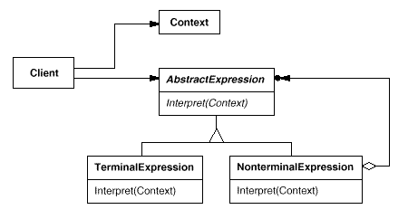
Interpreter Design Pattern
Structure

Slide 114
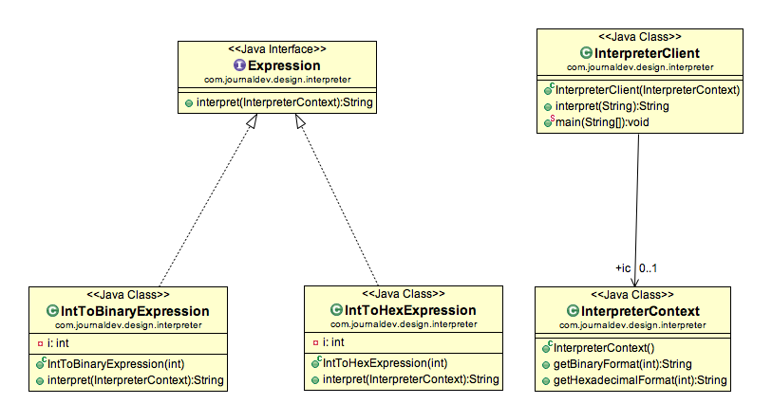
Interpreter Design Pattern
Example

Slide 115
public class InterpreterContext {
public String getBinaryFormat(int i){
return Integer.toBinaryString(i);
}
public String getHexadecimalFormat(int i){
return Integer.toHexString(i);
}
}

Slide 116
public interface Expression {
String interpret(InterpreterContext ic);
}
public class IntToBinaryExpression implements Expression {
private int i;
public IntToBinaryExpression(int c){
this.i=c;
}
@Override
public String interpret(InterpreterContext ic) {
return ic.getBinaryFormat(this.i);
}
}

Slide 117
public class IntToHexExpression implements Expression {
private int i;
public IntToHexExpression(int c){
this.i=c;
}
@Override
public String interpret(InterpreterContext ic) {
return ic.getHexadecimalFormat(i);
}
}

Slide 118
public class InterpreterClient {
public InterpreterContext ic;
public InterpreterClient(InterpreterContext i){
this.ic=I;}
public String interpret(String str){
Expression exp=null;
if(str.contains("Hexadecimal")){
exp= new IntToHexExpression(Integer.parseInt(str.substring(0,str.indexOf(” "))));
}else if(str.contains("Binary")){
exp=new IntToBinaryExpression(Integer.parseInt(str.substring(0,str.indexOf(" "))));
}else return str;
return exp.interpret(ic);
}
public static void main(String args[]){
String str1 = "28 in Binary";
String str2 = "28 in Hexadecimal”;
InterpreterClient ec = new InterpreterClient(new InterpreterContext());
System.out.println(str1+"= "+ec.interpret(str1));
System.out.println(str2+"= "+ec.interpret(str2));
}
}

Slide 119
Output:
28 in Binary= 11100
28 in Hexadecimal= 1c

