Slide 1
CPIT-252 Software Design Patterns
Model-View-Controller (MVC)
Last updated: 20/03/2022

Slide 2
Introduction (I)
As we have seen, patterns of patterns can appear in code in multiple forms such as the use multiple design patterns in a single system.
We’ll see how patterns of patterns can be used to create a whole new design pattern such as the Model-View-Controller (MVC) design pattern.
MVC provides a generic solution to the problem of displaying and interacting with the information stored in an application’s model classes which is kept in-sync with the data store.
MVC makes use of observer, strategy, composite and more.

Slide 3
Introduction (II)
MVC is widely used with GUI systems (e.g., desktop and web applications)
MVC is a ubiquitous compound design pattern that address two common problems in GUI programming:
How to provide an interactive and updated visual representation of the current state of the application?
How to keep a GUI system under control given the inherent complexity of communication between various components.

Slide 4
Introduction (III)
Architectural patterns are reusable solution to a commonly occurring problems in software architecture.
Architectural patterns are similar to software design patterns, but they have a more general or broader scope.
Model-View-Controller (MVC) was created by Trygve Reenskaug while a visiting scientist at the Xerox Palo Alto Research Center (PARC), in the late 1970s
MVC is an architectural design pattern that is widely used in Graphical User Interface (GUI) and web development.

Slide 5
Introduction (IV)
MVC aims to simplify the development of applications that involve users who interact with a system that retrieves and displays data.
MVC divides an application into three interconnected components: Model, View and Controller.
Model: Manages data related operations (get, insert, update, delete)
View: Renders presentation of the model in a particular format.
Controller: Responds to the user input and passes it to the Model.
The MVC pattern breaks up the code into separate manageable components.

Slide 6
Benefits of MVC
Separation of Concerns:
Separating the code into distinct sections, where each section addresses a separate concern.
Simplify the development
Build and test components independently.
Teams can work on different parts (e.g., a team working on Views without impacting the team that’s working on the Models).
Loose coupling
A model can be changed (e.g., change data store) without impacting the Views.
A view can be changed without impacting the Model.

Slide 7
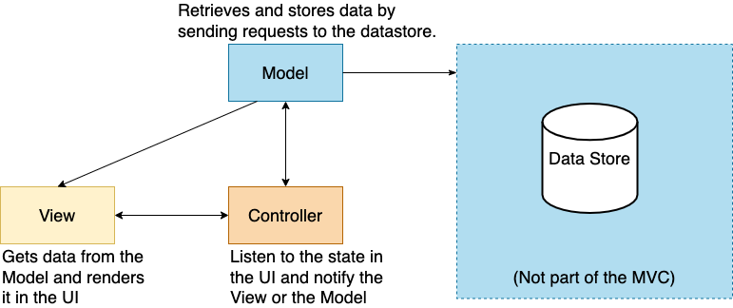
Model-View Controller: Architecture

Slide 8
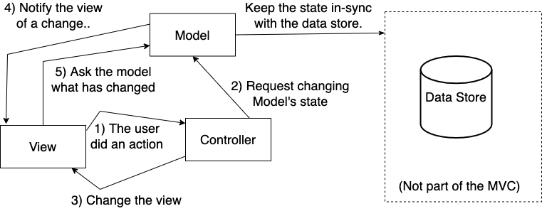
Model-View Controller: Structure

Slide 9
MVC Example: Video Player App (I)
Let’s take a closer look at how model, view, and controller in MVC with an example of a video player, like the one on YouTube.
The video player maintains a database with all videos along with their descriptions and data.
It also takes care of playing a playlist of videos and constantly updating the user interface with the current video title, description, comments, etc.
The user interacts with the View:
The view is the window to the model
When the user clicks on “play”, the View tells the Controller what happened.
It’s the Controller’s job to handle the “play” event

Slide 10
MVC Example: Video Player App (II)
The controller asks the model to change its state:
If the user clicks “play”, the controller decides how the model should be manipulated to handle this action (e.g., ask the model to increment view count).
The controller may also ask the view to change/update itself:\
If the user clicks “play”, the controller asks the view to enable the “pause”, ”fast-forward”, and “closed-caption” buttons) and disable the “play” button.
The model notifies the view when its state has changed:
If the user clicks “write a comment” or someone else’s wrote a comment, the model tells the view that its state has changed.

Slide 11
MVC Example: Video Player App (III)
The view asks the model for state.
When the model notifies the view that a new video has started playing, the view requests the video name, description, and associated comments from the model and displays it.
The view also may request the model for state as the result of the controller requesting change in the view (e.g., show a list of related videos next to the current video).

Slide 12
Model-View Controller: Model
The model manages the data for the application and is responsible for retrieving and storing data by interacting directly with the data store.
The model receives user input from the controller and processes it by making requests to the data store.
The data store can be a database, API, JSON object, message queue, or any place where data is stored in.
The model knows where the data is when asked by the controller.
Which database table or API is this data stored in?
Which SQL query to execute or API endpoint to call?

Slide 13
Model-View Controller: View
The View gets data from the Model and presents it to the user.
The view decides how the data is presented to the user in UI elements
Examples: a table inside a UI component in a desktop application, or a view in a mobile application or web page in a web application.
The View knows when and how to render UI elements:
It updates the current view when the Model is providing it with new data.
It changes the current view when the controller asks it as a result of a user interaction (e.g., when the user navigates to a new page, the controller will ask the View to render its UI elements).

Slide 14
Model-View Controller: Controller
The Controller handles the application logic and user inputs.
It listens for changes to the data in the model or the state in the UI and notifies the model or view accordingly.
The Controller knows how to respond to user actions:
The Controller notifies the View when the user navigates to a new page or asks the View to render the related UI elements (e.g., load a table view when the user clicks on view my orders).
The Controller asks the Model to update itself as a result of user input (e.g., the user clicks on delete an order, and the Controller will ask the Model to delete it from the data store).

Slide 15
MVC is sometimes misunderstood
The V in MVC: Views are misunderstood:
The Views can interpret the input and manipulate the model based on that.
This is dangerous for two reasons:
The view code becomes complicated because it has two jobs: managing the user’s input and managing the logic of controlling the model
The view would be tightly coupled with the model.
The C in MVC: Controllers are misunderstood:
All the Controller does is “send it to the model”
This is wrong the controller interpret the input and manipulate the model based on that.

Slide 16
MVC Variations: Pull-MVC vs. Push-MVC
Pull-MVC
Also known as “polling”, where you always need to call and ask for new data.
The View is not updated until it asks the Model for new data.
The view calls the model when it needs to retrieve new data.
Example: Refreshing Twitter homepage every 5 minutes to check for trending topics.
Push-MVC
The model notifies the view and passes its new state to the view when it has something new.
Once the model changes, it notifies the Views.
The view registers itself with the model for change notifications.
Example: Twitter shows newly posted tweets without having to reload the page.

Slide 17
MVC Example - Twitter
 | Model | View | Controller
User sign-in page
Authenticate user sign-in attempt
Check user credentials
Display a list of Tweets
User Retweets a Tweet
Store the Retweet details
User deletes a Tweet
Delete the Tweet’s record

Slide 18
MVC Example - Twitter
 | Model | View | Controller
User sign-in page |  | X
Authenticate user sign-in attempt
Check user credentials
Display a list of Tweets
User Retweets a Tweet
Store the Retweet details
User deletes a Tweet
Delete the Tweet’s record

Slide 19
MVC Example - Twitter
 | Model | View | Controller
User sign-in page |  | X
Authenticate user sign-in attempt |  |  | X
Check user credentials
Display a list of Tweets
User Retweets a Tweet
Store the Retweet details
User deletes a Tweet
Delete the Tweet’s record

Slide 20
MVC Example - Twitter
 | Model | View | Controller
User sign-in page |  | X
Authenticate user sign-in attempt |  |  | X
Check user credentials | X
Display a list of Tweets
User Retweets a Tweet
Store the Retweet details
User deletes a Tweet
Delete the Tweet’s record

Slide 21
MVC Example - Twitter
 | Model | View | Controller
User sign-in page |  | X
Authenticate user sign-in attempt |  |  | X
Check user credentials | X
Display a list of Tweets |  | X
User Retweets a Tweet
Store the Retweet details
User deletes a Tweet
Delete the Tweet’s record

Slide 22
MVC Example - Twitter
 | Model | View | Controller
User sign-in page |  | X
Authenticate user sign-in attempt |  |  | X
Check user credentials | X
Display a list of Tweets |  | X
User Retweets a Tweet |  |  | X
Store the Retweet details
User deletes a Tweet
Delete the Tweet’s record

Slide 23
MVC Example - Twitter
 | Model | View | Controller
User sign-in page |  | X
Authenticate user sign-in attempt |  |  | X
Check user credentials | X
Display a list of Tweets |  | X
User Retweets a Tweet |  |  | X
Store the Retweet details | X
User deletes a Tweet
Delete the Tweet’s record

Slide 24
MVC Example - Twitter
 | Model | View | Controller
User sign-in page |  | X
Authenticate user sign-in attempt |  |  | X
Check user credentials | X
Display a list of Tweets |  | X
User Retweets a Tweet |  |  | X
Store the Retweet details | X
User deletes a Tweet |  |  | X
Delete the Tweet’s record

Slide 25
MVC Example - Twitter
 | Model | View | Controller
User sign-in page |  | X
Authenticate user sign-in attempt |  |  | X
Check user credentials | X
Display a list of Tweets |  | X
User Retweets a Tweet |  |  | X
Store the Retweet details | X
User deletes a Tweet |  |  | X
Delete the Tweet’s record | X

Slide 26
MVC & Compound Patterns (I)
The MVC pattern internally utilized multiple design patterns:
The observer pattern is used on Models with variant implementations:
The views keep track of changes on models via the observer design pattern.
Or the Controllers observe the models and notify the views of a change.
The strategy pattern is used on Views and Controllers:
The views delegate events to their current controllers.
The composite pattern is used on Views
The controller tells the root view element to update itself and all its sub-components in the tree structure (e.g., panels, text fields, buttons, etc.)
The command pattern is used to trigger and handle events
The decorator pattern is used on Views to dynamically add behaviors.

Slide 27
MVC Java Example

Slide 28
MVC Swing Example

Slide 29
MVC Spring Framework Example

