Slide 1
Structural Design Patterns
Software Design Patterns
CPIT-252

Slide 2
Structural Design Patterns
Concerned with how classes and objects are composed to form larger structures
In structural class patterns, we use inheritance to compose interfaces and implementations
In structural object patterns, we use object composition to realize new functionality
Object composition adds flexibility due to its ability to change the composition at run-time

Slide 3
Structural Design Patterns
Adapter
Bridge
Composite
Decorator
Façade
Flyweight
Proxy

Slide 4
Adapter Design Pattern
Intent
Convert the interface into another interface the clients expect
Lets classes work together that could not otherwise because of incompatible interfaces

Slide 5
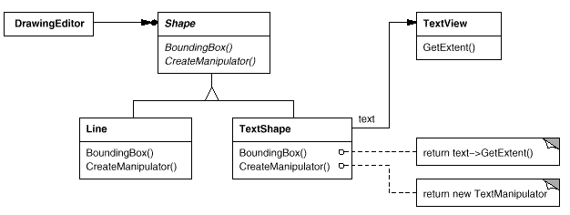
Adapter Design Pattern
Motivation

Slide 6
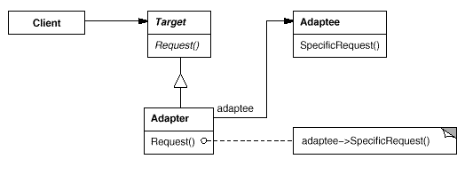
Adapter Design Pattern
Structure: object adapter relies on object composition

Slide 7
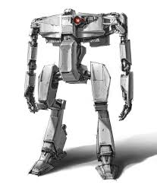
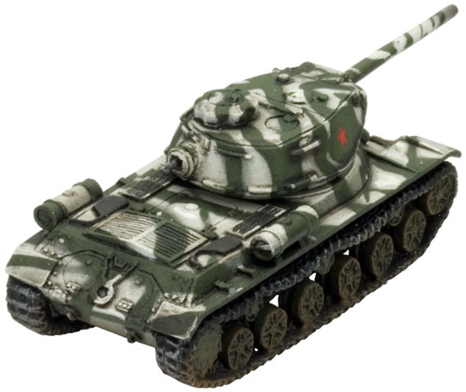
Adapter Design Pattern
Example
Target
Client
<<interface>> EnemyAttacker
EnemyRobot
EnemyRobotAdapter
EnemyTank
Adaptee
Adapter

Slide 8
public interface EnemyAttacker {
public void fireWeapon();
public void driveForward();
public void assignDriver(String driverName);
}

Slide 9
import java.util.Random;
public class EnemyTank implements EnemyAttacker{
Random generator = new Random();
@Override
public void fireWeapon() {
int attackDamage = generator.nextInt(10) + 1;
System.out.println("Enemy Tank Does " + attackDamage + " Damage");
}
@Override
public void driveForward() {
int movement = generator.nextInt(5) + 1;
System.out.println("Enemy Tank moves " + movement + " spaces");
}
@Override
public void assignDriver(String driverName) {
System.out.println(driverName + " is driving the tank");
}
}

Slide 10
import java.util.Random;
public class EnemyRobot{
Random generator = new Random();
public void smashWithHands() {
int attackDamage = generator.nextInt(10) + 1;
System.out.println("Enemy Robot Causes " + attackDamage + " Damage
With Its Hands"); }
public void walkForward() {
int movement = generator.nextInt(5) + 1;
System.out.println("Enemy Robot Walks Forward " + movement + " spaces");
}
public void reactToHuman(String driverName) {
System.out.println("Enemy Robot Tramps on " + driverName);
}
}

Slide 11
public class EnemyRobotAdapter implements EnemyAttacker{
EnemyRobot theRobot;
public EnemyRobotAdapter(EnemyRobot newRobot){
theRobot = newRobot; }
public void fireWeapon() {
theRobot.smashWithHands(); }
public void driveForward() {
theRobot.walkForward(); }
public void assignDriver(String driverName) {
theRobot.reactToHuman(driverName); }
}

Slide 12
public class Client {
public static void main(String[] args){
EnemyTank rx7Tank = new EnemyTank();
EnemyRobot fredTheRobot = new EnemyRobot();
EnemyAttacker robotAdapter = new EnemyRobotAdapter(fredTheRobot);
System.out.println("The Robot");
fredTheRobot.reactToHuman("Paul");
fredTheRobot.walkForward();
fredTheRobot.smashWithHands();
System.out.println("The Enemy Tank");
rx7Tank.assignDriver("Frank");
rx7Tank.driveForward();
rx7Tank.fireWeapon();
System.out.println("The Robot with Adapter");
robotAdapter.assignDriver("Mark");
robotAdapter.driveForward();
robotAdapter.fireWeapon();
} }
Same output

Slide 13
Adapter Design Pattern
Applicability
You want to use an existing class, and its interface does not match the one you need.

Slide 14
Adapter Design Pattern
Consequences
Lets a single Adapter work with many Adaptees
The Adaptee itself and all of its subclasses (if any)
The Adapter can also add functionality to all Adaptees at once
Makes it harder to override Adaptee behavior
It will require subclassing Adaptee and making Adapter refer to the subclass rather than the Adaptee itself

Slide 15
Bridge Design Pattern
Intent
The Bridge Pattern is used to separate out the interface from its implementation
Adding functionality by separating major differences using abstract classes

Slide 16
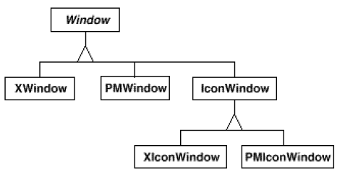
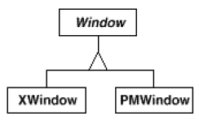
Bridge Design Pattern
Motivation

Slide 17
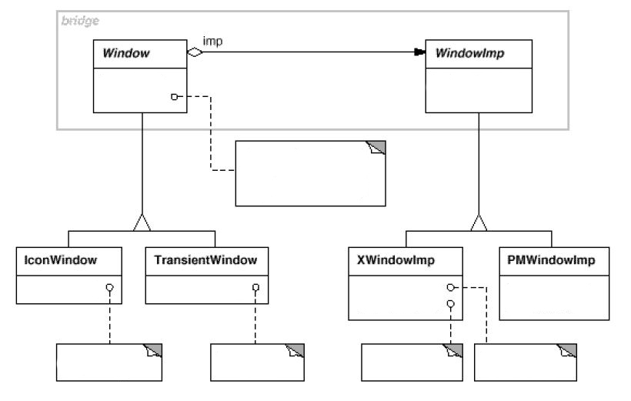
Bridge Design Pattern
Bridge

Slide 18
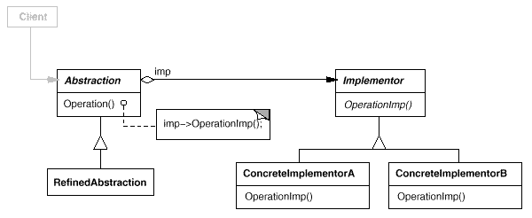
Bridge Design Pattern
Structure

Slide 19
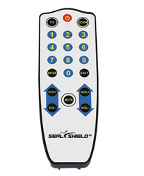
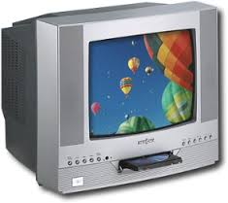
Bridge Design Pattern

Slide 20
Bridge Design Pattern
Example
Client
Abstraction
Implementer
RemoteButton
EntertainmentDevice
TVRemotePause
TVRemoteMute
DVDDevice
TVDevice
Refine Abstraction
Concrete implementation

Slide 21
public abstract class EntertainmentDevice {
public int deviceState;
public int maxSetting;
public int volumeLevel = 0;
public abstract void buttonFivePressed();
public abstract void buttonSixPressed();
public void deviceFeedback() {
if(deviceState > maxSetting || deviceState < 0) { deviceState = 0; }
System.out.println("On Channel " + deviceState); }
public void buttonSevenPressed() {
volumeLevel++;
System.out.println("Volume at: " + volumeLevel);}
public void buttonEightPressed() {
volumeLevel--;
System.out.println("Volume at: " + volumeLevel); }
}

Slide 22
public class TVDevice extends EntertainmentDevice {
public TVDevice(int newDeviceState, int newMaxSetting){
deviceState = newDeviceState;
maxSetting = newMaxSetting; }
@Override
public void buttonFivePressed() {
System.out.println("Channel Down");
deviceState--; }
@Override
public void buttonSixPressed() {
System.out.println("Channel Up");
deviceState++;
}
}

Slide 23
public class DVDDevice extends EntertainmentDevice{
public DVDDevice(int newDeviceState, int newMaxSetting){
super.deviceState = newDeviceState;
super.maxSetting = newMaxSetting; }
@Override
public void buttonFivePressed() {
System.out.println("DVD Skips to Chapter");
deviceState--; }
@Override
public void buttonSixPressed() {
System.out.println("DVD go to next Chapter");
deviceState++; }
}

Slide 24
public abstract class RemoteButton{
private EntertainmentDevice theDevice;
public RemoteButton(EntertainmentDevice newDevice){
theDevice = newDevice; }
public void buttonFivePressed() {
theDevice.buttonFivePressed(); }
public void buttonSixPressed() {
theDevice.buttonSixPressed(); }
public void deviceFeedback(){
theDevice.deviceFeedback(); }
public abstract void buttonNinePressed();
}

Slide 25
public class TVRemoteMute extends RemoteButton {
public TVRemoteMute(EntertainmentDevice newDevice) {
super(newDevice);
}
@Override
public void buttonNinePressed() {
System.out.println("TV was Muted"); }
}

Slide 26
public class TVRemotePause extends RemoteButton{
public TVRemotePause(EntertainmentDevice newDevice) {
super(newDevice); }
@Override
public void buttonNinePressed() {
System.out.println("TV was Muted”); }
}

Slide 27
public class TestTheRemote {
public static void main(String[] args) {
TVDevice tvd = new TVDevice(1,200);
RemoteButton theTV = new TVRemoteMute(tvd);
RemoteButton theTV2 = new TVRemotePause(tvd);
System.out.println("Test TV with Mute");
theTV.buttonFivePressed();
theTV.buttonSixPressed();
theTV.buttonNinePressed();
System.out.println("\nTest TV with Pause");
theTV2.buttonFivePressed();
theTV2.buttonSixPressed();
theTV2.buttonNinePressed();
theTV2.deviceFeedback();
}
}

Slide 28
Bridge Design Pattern
Applicability
You want to avoid a permanent binding between an abstraction and its implementation
E.g., when the implementation must be selected or switched at run-time
Bridge pattern lets you combine the different abstractions and implementations and extend them independently
Changes in the implementation of an abstraction should have no impact on clients

Slide 29
Bridge Design Pattern
Consequences
Decoupling interface/abstract classes and implementation
Improve extensibility: you can extend the abstraction and implementer hierarchies independently
Hiding implementation details from clients.

Slide 30
Composite Design Pattern
Intent
Compose objects into tree structures to represent part-whole hierarchies
Composite lets clients treat individual objects and compositions of objects uniformly

Slide 31
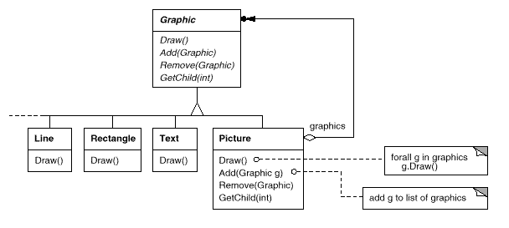
Composite Design Pattern
Motivation

Slide 32
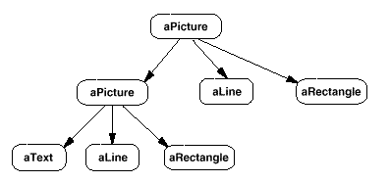
Composite Design Pattern
Motivation

Slide 33
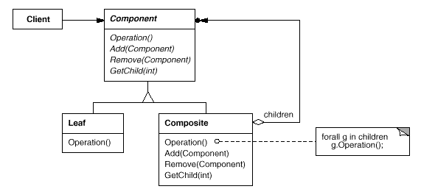
Composite Design Pattern
Structure

Slide 34
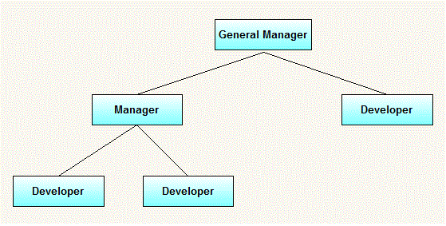
Composite Design Pattern
Example:
In a small organization, there are 5 employees. At top position, there is 1 general manager. Under general manager, there are two employees, one is manager and other is developer and further manager has two developers working under him. We want to print name and salary of all employees from top to bottom.

Slide 35
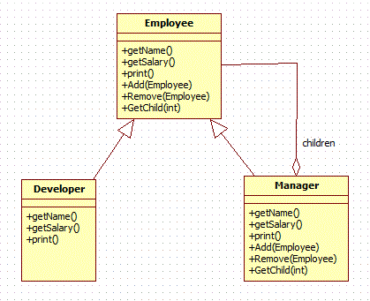
Composite Design Pattern
Example

Slide 36
public interface Employee {
public String getName();
public double getSalary();
public void print();
public void add(Employee employee);
public void remove(Employee employee);
public Employee getChild(int i);
}

Slide 37
public class Developer implements Employee{
private String name;
private double salary;
public Developer(String name,double salary){
this.name = name;
this.salary = salary; }
public String getName() {
return name; }
public double getSalary() {
return salary; }
public void print() {
System.out.println("Name ="+getName());
System.out.println("Salary ="+getSalary());}
public void remove(Employee employee) { }
public void add(Employee employee) { }
public Employee getChild(int i) { return null; }
}
}
Methods are not applicable for the leaves because its just valid for the whole

Slide 38
import java.util.ArrayList;
import java.util.Iterator;
import java.util.List;
public class Manager implements Employee{
private String name;
private double salary;
List<Employee> employees = new ArrayList<Employee>();
public Manager(String name,double salary){
this.name = name;
this.salary = salary; }
public String getName() {
return name; }
public double getSalary() {
return salary;
}

Slide 39
public void add(Employee employee) {
employees.add(employee); }
public void remove(Employee employee) {
employees.remove(employee);
}
public Employee getChild(int i) {
return employees.get(i); }
public void print() {
System.out.println("Name ="+getName());
System.out.println("Salary ="+getSalary());
Iterator<Employee> employeeIterator = employees.iterator();
while(employeeIterator.hasNext()){
Employee employee = employeeIterator.next();
employee.print();
}
}
}

Slide 40
public class CompositeDesignPatternMain {
public static void main(String[] args) {
Employee emp1=new Developer("John", 10000);
Employee emp2=new Developer("David", 15000);
Employee manager1=new Manager("Daniel",25000);
manager1.add(emp1);
manager1.add(emp2);
Employee emp3=new Developer("Michael", 20000);
Manager generalManager=new Manager("Mark", 50000);
generalManager.add(emp3);
generalManager.add(manager1);
generalManager.print();
}
}

Slide 41
-------------
Name =Mark
Salary =50000.0
-------------
-------------
Name =Michael
Salary =20000.0
-------------
-------------
Name =Daniel
Salary =25000.0
-------------
-------------
Name =John
Salary =10000.0
-------------
-------------
Name =David
Salary =15000.0
-------------

Slide 42
Composite Design Pattern
Applicability
You want to represent part-whole hierarchies of objects
You want clients to be able to ignore the difference between compositions of objects and individual objects. Clients will treat all objects in the composite structure uniformly

Slide 43
Composite Design Pattern
Consequences
Defines class hierarchies consisting of primitive objects and composite objects. Primitive objects can be composed into more complex objects
Clients can treat composite structures and individual objects uniformly
Makes it easier to add new kinds of components. Newly defined Composite or Leaf subclasses work automatically with existing structures and client code. Clients don't have to be changed for new Component classes

Slide 44
Decorator Design Pattern
Intent
Attach additional responsibilities to an object dynamically
Decorators provide a flexible alternative to subclassing for extending functionality.

Slide 45
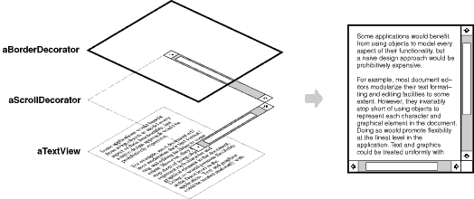
Decorator Design Pattern
Motivation

Slide 46
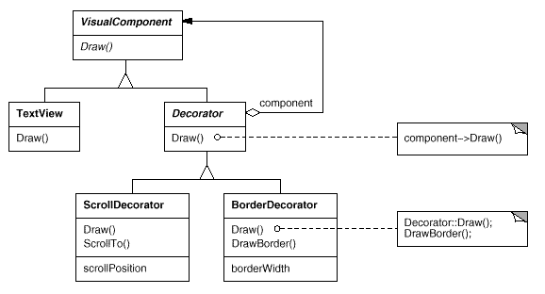
Decorator Design Pattern
Motivation

Slide 47
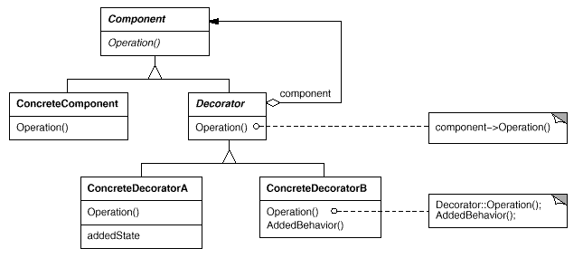
Decorator Design Pattern
Structure

Slide 48
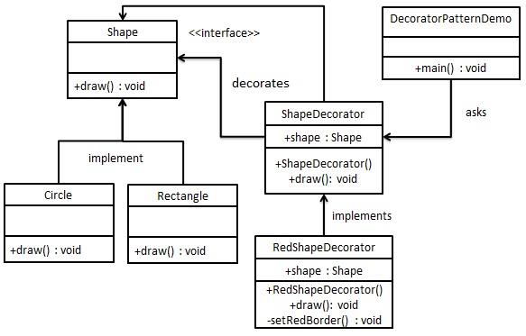
Decorator Design Pattern
Example

Slide 49
public interface Shape {
void draw(); }
public class Rectangle implements Shape {
@Override
public void draw() {
System.out.println("Shape: Rectangle");
}
}
public class Circle implements Shape {
@Override
public void draw() {
System.out.println("Shape: Circle");
}
}

Slide 50
public abstract class ShapeDecorator implements Shape {
protected Shape decoratedShape;
public ShapeDecorator(Shape decoratedShape){
this.decoratedShape = decoratedShape;
}
public void draw(){
decoratedShape.draw();
}
}

Slide 51
public class RedShapeDecorator extends ShapeDecorator {
public RedShapeDecorator(Shape decoratedShape) {
super(decoratedShape);
}
@Override
public void draw() {
decoratedShape.draw();
setRedBorder(decoratedShape);
}
private void setRedBorder(Shape decoratedShape){
System.out.println("Border Color: Red");
}
}

Slide 52
public class DecoratorPatternDemo {
public static void main(String[] args) {
Shape circle = new Circle();
Shape redCircle = new RedShapeDecorator(new Circle());
Shape redRectangle = new RedShapeDecorator(new Rectangle());
System.out.println("Circle with normal border");
circle.draw();
System.out.println("\nCircle of red border");
redCircle.draw();
System.out.println("\nRectangle of red border");
redRectangle.draw();
}
}

Slide 53
Circle with normal border
Shape: Circle
Circle of red border
Shape: Circle
Border Color: Red
Rectangle of red border
Shape: Rectangle
Border Color: Red

Slide 54
Decorator Design Pattern
Applicability
Add responsibilities to individual objects dynamically without affecting other objects
Responsibilities can be withdrawn
When extension by subclassing is impractical. Sometimes a large number of independent extensions are possible and would produce an explosion of subclasses to support every combination.
Pizza example: create subclass for each type of pizza, and if price of one topping changes, you should change it in all subclasses used it.

Slide 55
Decorator Design Pattern
Consequences
More flexibility than static inheritance
You can define a simple class and add functionality incrementally with Decorator objects
A design that uses Decorator often results in systems composed of lots of little objects. Although these systems are easy to customize by those who understand them, they can be hard to learn and debug

Slide 56
Façade Design Pattern
Intent
Provide a unified interface to a set of interfaces in a subsystem
Facade defines a higher-level interface that makes the subsystem easier to use

Slide 57
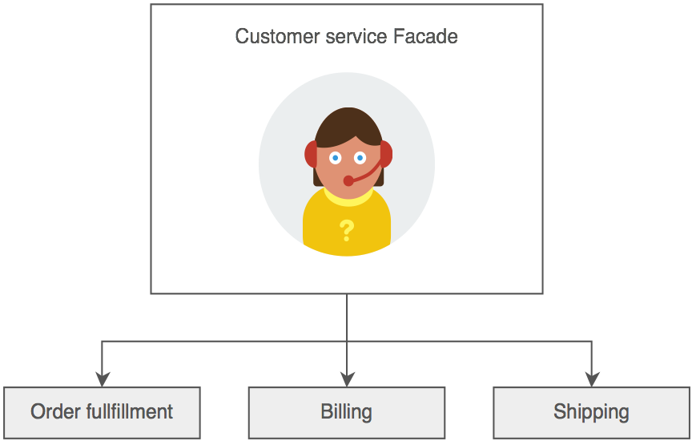
Façade Design Pattern
Motivation:
The consumer calls one number and speaks with a customer service representative. The customer service representative acts as a Facade, providing an interface to the order fulfillment department, the billing department, and the shipping department.

Slide 58
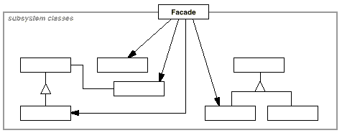
Façade Design Pattern
Structure

Slide 59
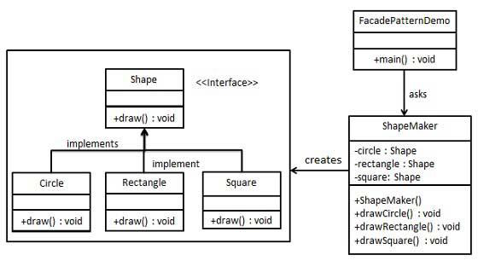
Façade Design Pattern
Example
Client
Subsystems
Facade

Slide 60
public interface Shape {
void draw();
}
public class Rectangle implements Shape {
@Override
public void draw() {
System.out.println("Rectangle::draw()");
}
}

Slide 61
public class Square implements Shape {
@Override
public void draw() {
System.out.println("Square::draw()");
}
}
public class Circle implements Shape {
@Override
public void draw() {
System.out.println("Circle::draw()");
}
}

Slide 62
public class ShapeMaker {
private Shape circle;
private Shape rectangle;
private Shape square;
public ShapeMaker() {
circle = new Circle();
rectangle = new Rectangle();
square = new Square(); }
public void drawCircle(){
circle.draw(); }
public void drawRectangle(){
rectangle.draw(); }
public void drawSquare(){
square.draw(); }
}
Façade Class

Slide 63
public class FacadePatternDemo {
public static void main(String[] args) {
ShapeMaker shapeMaker = new ShapeMaker();
shapeMaker.drawCircle();
shapeMaker.drawRectangle();
shapeMaker.drawSquare();
}
}

Slide 64
Output:
Circle::draw()
Rectangle::draw()
Square::draw()

Slide 65
Façade Design Pattern
Applicability
You want to provide a simple interface to a complex subsystem. A facade can provide a simple default view of the subsystem that is good enough for most clients.
There are many dependencies between clients and the implementation classes of an abstraction. Introduce a facade to decouple the subsystem from clients and other subsystem
Use a facade to define an entry point to each subsystem level

Slide 66
Façade Design Pattern
Consequences
It shields clients from subsystem components, thereby reducing the number of objects that clients deal with and making the subsystem easier to use
It promotes weak coupling between the subsystem and its clients. Weak coupling lets you vary the components of the subsystem without affecting its clients
It doesn't prevent applications from using subsystem classes if they need to.

Slide 67
Flyweight Design Pattern
Intent
To reduce the number of objects created and to decrease memory footprint and increase performance
Reuse already existing similar kind objects by storing them and creates new object when no matching object is found

Slide 68
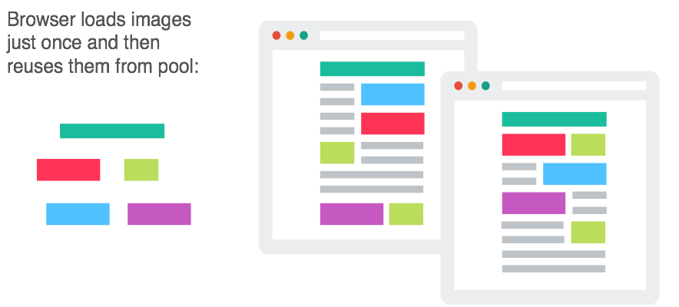
Flyweight Design Pattern
Motivation
Web browsers use this technique to prevent loading same images twice. When browser loads a web page, it traverse through all images on that page. Browser loads all new images from Internet and places them the internal cache. For already loaded images, a flyweight object is created, which has some unique data like position within the page, but everything else is referenced to the cached one

Slide 69
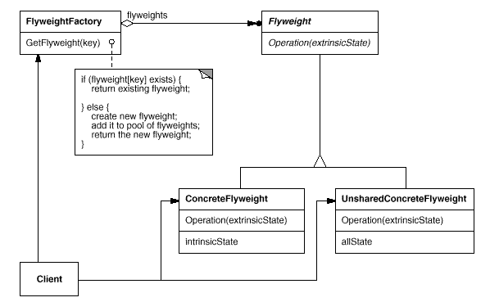
Flyweight Design Pattern
Structure

Slide 70
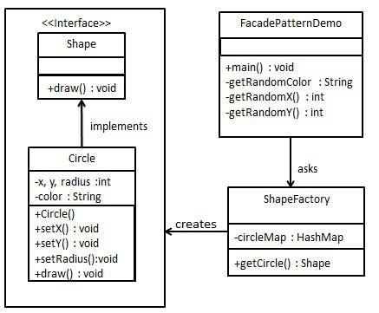
Flyweight Design Pattern
Example

Slide 71
public interface Shape {
void draw();
}

Slide 72
public class Circle implements Shape {
private String color;
private int x;
private int y;
private int radius;
public Circle(String color){
this.color = color; }
public void setX(int x) {
this.x = x;}
public void setY(int y) {
this.y = y;}
public void setRadius(int radius) {
this.radius = radius;}
@Override
public void draw() {
System.out.println("Circle: Draw() [Color : " + color + ", x : " + x +
", y :" + y + ", radius :" + radius);}
}

Slide 73
import java.util.HashMap;
public class ShapeFactory {
private static final HashMap<String, Shape> circleMap = new HashMap();
public static Shape getCircle(String color) {
Circle circle = (Circle)circleMap.get(color);
if(circle == null) {
circle = new Circle(color);
circleMap.put(color, circle);
System.out.println("Creating circle of color : " + color);
}
return circle;
}
}

Slide 74
public class FlyweightPatternDemo {
private static final String colors[] = { "Red", "Green", "Blue", "White", "Black" };
public static void main(String[] args) {
for(int i=0; i < 20; ++i) {
Circle circle = (Circle)ShapeFactory.getCircle(getRandomColor());
circle.setX(getRandomX());
circle.setY(getRandomY());
circle.setRadius(100);
circle.draw(); }
}
private static String getRandomColor() {
return colors[(int)(Math.random()*colors.length)]; }
private static int getRandomX() {
return (int)(Math.random()*100 ); }
private static int getRandomY() {
return (int)(Math.random()*100);}
}

Slide 75
Output:
Creating circle of color : Black
Circle: Draw() [Color : Black, x : 36, y :71, radius :100
Creating circle of color : Green
Circle: Draw() [Color : Green, x : 27, y :27, radius :100
Creating circle of color : White
Circle: Draw() [Color : White, x : 64, y :10, radius :100
Creating circle of color : Red
Circle: Draw() [Color : Red, x : 15, y :44, radius :100
Circle: Draw() [Color : Green, x : 19, y :10, radius :100
Circle: Draw() [Color : Green, x : 94, y :32, radius :100
Circle: Draw() [Color : White, x : 69, y :98, radius :100
Creating circle of color : Blue
Circle: Draw() [Color : Blue, x : 13, y :4, radius :100
Circle: Draw() [Color : Green, x : 21, y :21, radius :100
Circle: Draw() [Color : Blue, x : 55, y :86, radius :100
Circle: Draw() [Color : White, x : 90, y :70, radius :100
Circle: Draw() [Color : Green, x : 78, y :3, radius :100
Circle: Draw() [Color : Green, x : 64, y :89, radius :100
Circle: Draw() [Color : Blue, x : 3, y :91, radius :100
Circle: Draw() [Color : Blue, x : 62, y :82, radius :100
Circle: Draw() [Color : Green, x : 97, y :61, radius :100
Circle: Draw() [Color : Green, x : 86, y :12, radius :100
Circle: Draw() [Color : Green, x : 38, y :93, radius :100
Circle: Draw() [Color : Red, x : 76, y :82, radius :100
Circle: Draw() [Color : Blue, x : 95, y :82, radius :100

Slide 76
Flyweight Design Pattern
Applicability
An application uses a large number of objects.
Storage costs are high
Most object state can be made extrinsic
Many groups of objects may be replaced by relatively few shared objects once extrinsic state is removed

Slide 77
Flyweight Design Pattern
Consequences
Reduce memory usage by sharing similar objects rather than creating new ones

Slide 78
Proxy Design Pattern
Intent
Provide a surrogate or placeholder for another object to control access to it

Slide 79
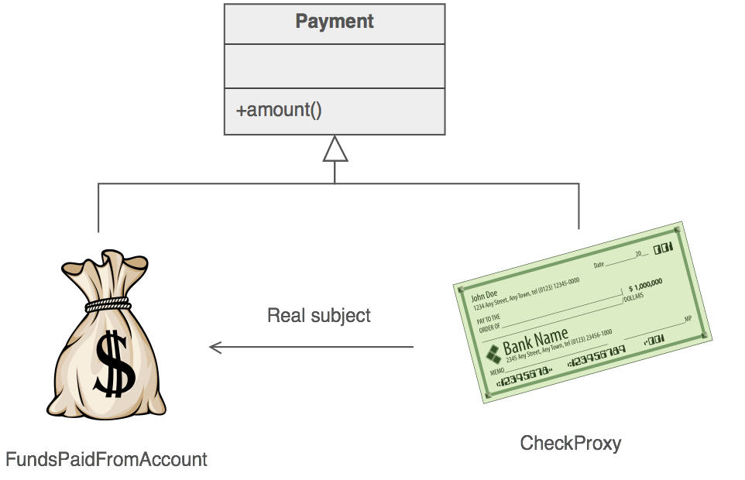
Proxy Design Pattern
Motivation:
The Proxy provides a surrogate or place holder to provide access to an object. A check or bank draft is a proxy for funds in an account. A check can be used in place of cash for making purchases and ultimately controls access to cash in the issuer's account.

Slide 80
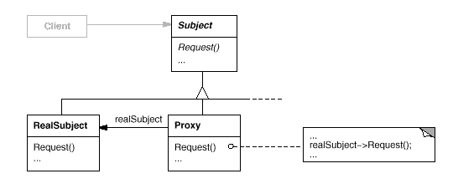
Proxy Design Pattern
Structure

Slide 81
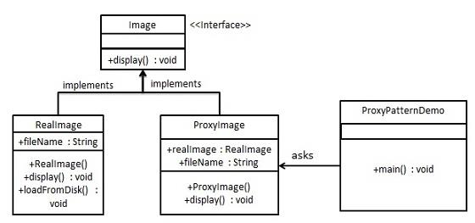
Proxy Design Pattern
Example

Slide 82
public interface Image {
void display();
}
public class RealImage implements Image {
private String fileName;
public RealImage(String fileName){
this.fileName = fileName;
loadFromDisk(fileName); }
@Override
public void display() {
System.out.println("Displaying " + fileName); }
private void loadFromDisk(String fileName){
System.out.println("Loading " + fileName); }
}

Slide 83
public class ProxyImage implements Image{
private RealImage realImage;
private String fileName;
public ProxyImage(String fileName){
this.fileName = fileName; }
@Override
public void display() {
if(realImage == null){
realImage = new RealImage(fileName);
}
realImage.display();
}
}

Slide 84
public class ProxyPatternDemo {
public static void main(String[] args) {
Image image = new ProxyImage("test_10mb.jpg");
image.display();
System.out.println("");
image.display();
}
}

Slide 85
Output:
Loading test_10mb.jpg
Displaying test_10mb.jpg
Displaying test_10mb.jpg

Slide 86
Proxy Design Pattern
Applicability
A virtual proxy creates expensive objects on demand
A protection proxy controls access to the original object
A remote proxy provides a local representative for an object in a different address space

Slide 87
Proxy Design Pattern
Consequences
The Proxy pattern introduces a level of indirection when accessing an object
A remote proxy can hide the fact that an object resides in a different address space.
A virtual proxy can perform optimizations such as creating an object on demand
Both protection proxies and smart references allow additional management tasks when an object is accessed.

